Slide 1
Digital Controls Final
Fall 2019
Noelle Lewandowski, Casey Bruno, Joao Barbosa,
Adam Pienkowski, and Don Webster

Slide 2
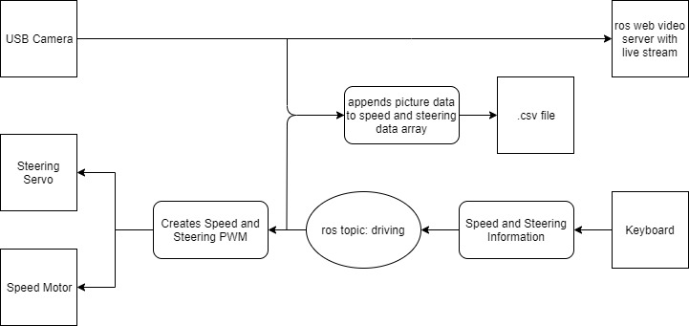
System Architecture
usb_cam
collectData.py
runcar.py
keyboard_input.py
Notes:
Noelle

Slide 3
System Architecture (continued)
keyboard_input.py
This sets up the keyboard input from a machine connected to the same ros network (publishes data to rostopic ‘driving’)
runcar.py
This subscribes to the topic ‘driving’ and gets steering and speed data from keyboard, creates, and sends PWM signal
usb_cam
ros package that streams usb_cam images
collectData.py
Creates csv file by listening to the ‘driving’ topic and taking data from the usb_cam package
Array where first two items are speed, and steering. The rest is the image’s data
Each new row in the .csv is a new frame or change in speed/direction

Slide 4
API Interface
usb_cam (in catkin_ws):
roslaunch usb_cam usb_cam-test.launch
runcar.py:
rosrun templecar runcar.py
collectData.py:
rosrun templecar collectData.py <filename.csv>
keyboard_input.py:
rosrun templecar keyboard_input.py
Notes:
Problems:
Difficult to change image size leading to slow data recording
Unix cannot take keyboard input in python easily

Slide 5
API Interfaces (continued)
Difficult to change image size leading to slow data recording
Unix cannot take keyboard input in python easily

Slide 6
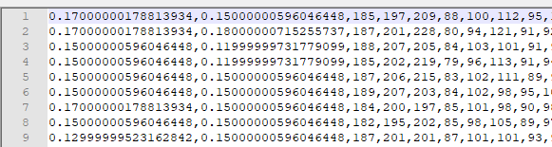
Data Collected (data)

Slide 7
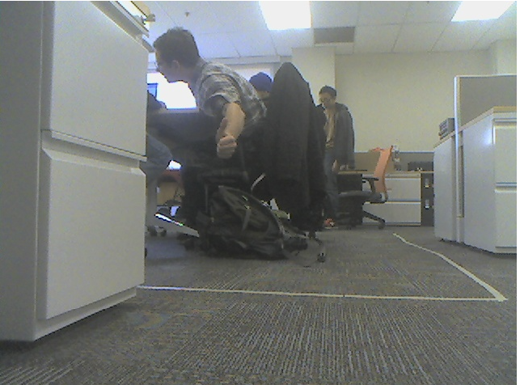
Data Collected (Image)

Slide 8
Conclusion
Usage of ROS
Allowed us to delegate different tasks to integrate later
Can split computations to different machines
Control
‘WASD’-style controls to move car
Image processing
Steering, speed, and image data saved to a CSV file
Can be used as training data at a later date
Git: https://github.com/DonStoddard5/templecarmk3/blob/master/README.md
Notes:
Don/Adam

Slide 9
Future Work
Incremental steering and speed control
Rewriting the keyboard commands to be more complicated
Save csv on separate machine
Ros communication (Master URI)
Camera Image Data Compression
compressed_image_transport ros package
Faster Data Recording
Comes after compressed image data
Ros launch file
runcar.py
collectData.py; keyboard_input.py

Slide 10
Future Work (continued)
Machine Learning for autonomous driving
Training data required
Car doesn’t drive straight
Weight distribution on car
Network Dropped
Create a ‘safety’ where if no communication comes in for a certain amount of time, then it automatically shuts down

